Slide 1
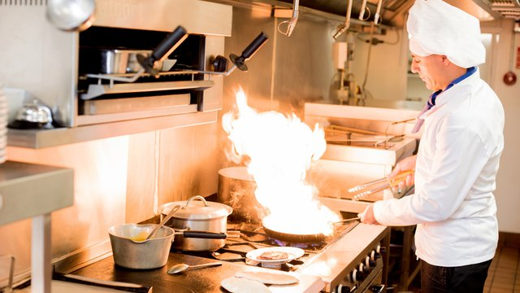
INTRODUCTION
FOOD SAFETY IN RESTAURANT KITCHEN

Slide 2

FOOD SAFETY IN RESTAURANT KITCHEN
Promoting hand wash is imperative for restaurant kitchens.
This would be promoted by establishing a hand washing station for employees.
This would minimize cross-contamination by having employees washing hands before touching any food.
Even the smallest bacteria can make one sick if its on a piece of food. Hand washing is key.

Slide 3

FOOD SAFETY IN RESTAURANT KITCHEN
Sick workers should not be allowed to make food.
When workers at a restaurant are suffering from suffering or diarrhea, they should be kept away from food.
If they happen to prepare food, they are putting customers’ health at risk.
This should be common sense for restaurant owners, they do not need safety tips to know that.

Slide 4
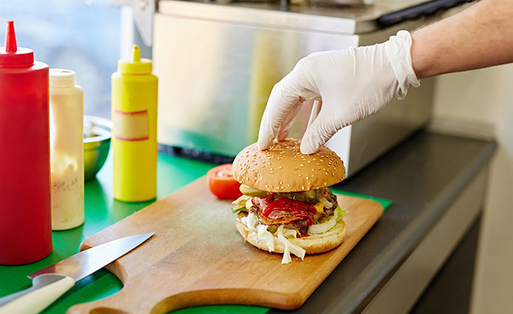
FOOD SAFETY IN RESTAURANT KITCHEN
Use of gloves should be embraced.
Workers in restaurant kitchens should be wearing gloves when preparing food.
However, they cannot use the same gloves for different ingredients. They have to change when moving from one ingredient to another.
In the event they don’t change the gloves, they can spread contaminants to customers food which may result to food poisoning

Slide 5
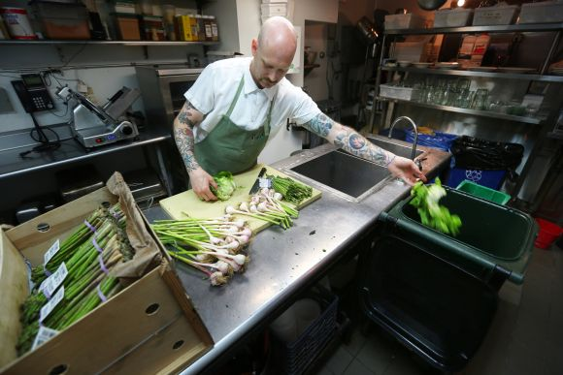
FOOD SAFETY IN RESTAURANT KITCHEN
Food should be washed properly.
Foods such as fruits and vegetables should be washed properly.
Even if the vegetables will be peeled or skinned, they require thorough washing or the workers risk spreading contamination to customers.

Slide 6
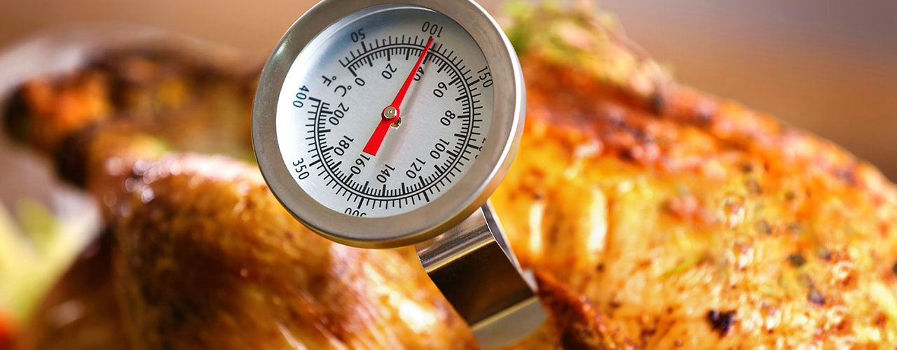
FOOD SAFETY IN RESTAURANT KITCHEN
Food should be cooked to the right temperature.
It is an imperative tip to know safe food temperature zones.
For instance beef should be at 155 degrees for 15 seconds.
This is to prevent E-coli found in food ground which accounts for many cases of food illnesses.

Slide 7
Reference
Park, S. H., Kwak, T. K., & Chang, H. J. (2010). Evaluation of the food safety training for food handlers in restaurant operations. Nutrition research and practice, 4(1), 58-68.
Brown, L. G., Le, B., Wong, M. R., Reimann, D., Nicholas, D., Faw, B., ... & Selman, C. A. (2014). Restaurant manager and worker food safety certification and knowledge. Foodborne pathogens and disease, 11(11), 835-843.

